Slide 1


Slide 2
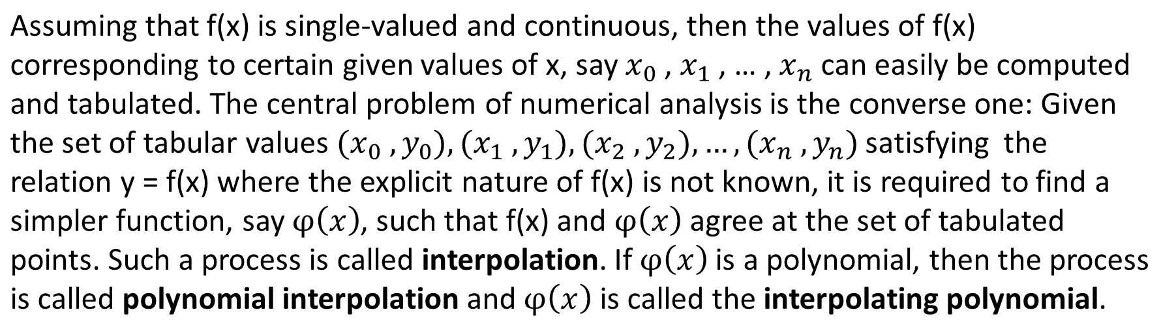

Numerical Methods
INTERPOLATION
National University of Science and Technology, Islamabad

Slide 3

Numerical Methods
Shifting Operator
Forward Difference Operator
Backward Difference Operator
Central Difference Operator
Averaging Operator
National University of Science and Technology, Islamabad

Slide 4
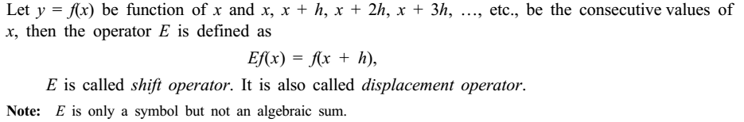
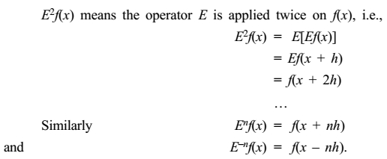
Numerical Methods
Shifting Operator
National University of Science and Technology, Islamabad

Slide 5
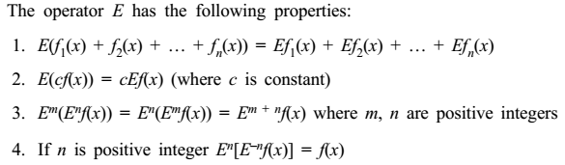
Numerical Methods
National University of Science and Technology, Islamabad

Slide 6
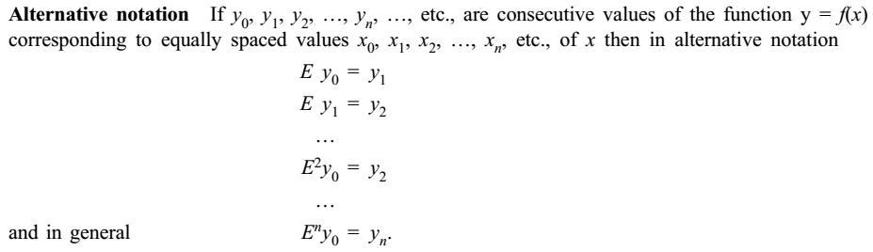
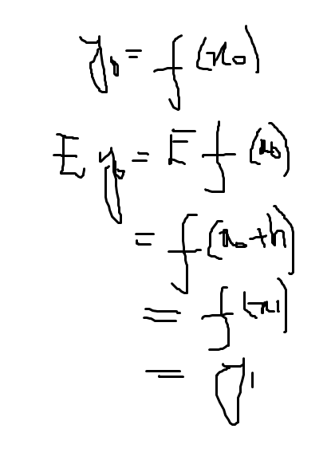
Numerical Methods
National University of Science and Technology, Islamabad

Slide 7
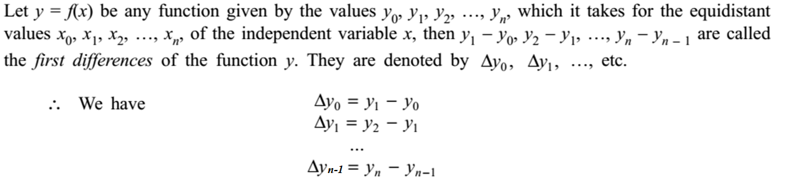
Numerical Methods
National University of Science and Technology, Islamabad

Slide 8
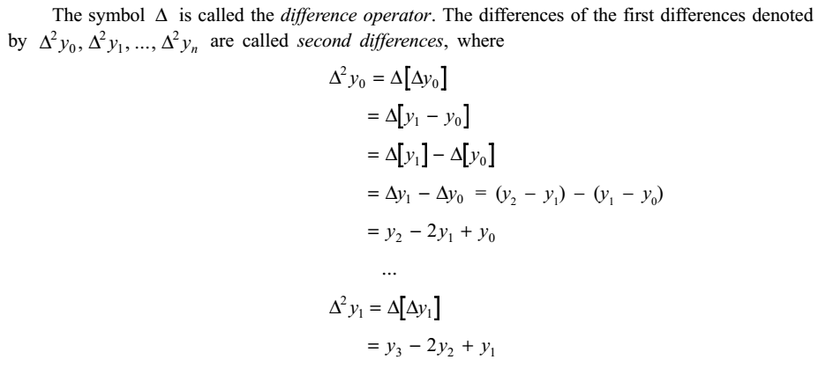
Numerical Methods
National University of Science and Technology, Islamabad

Slide 9
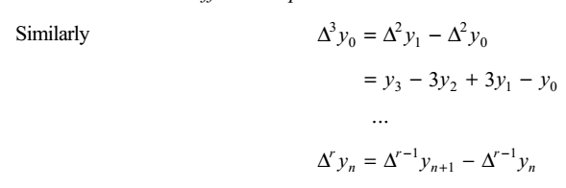
Numerical Methods
National University of Science and Technology, Islamabad

Slide 10
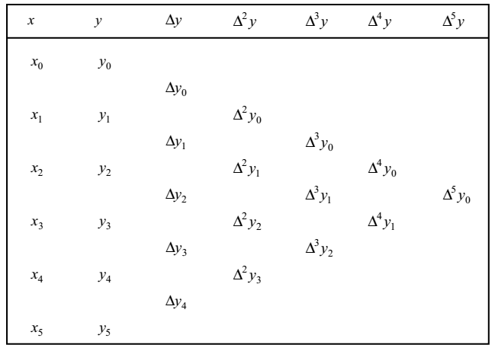
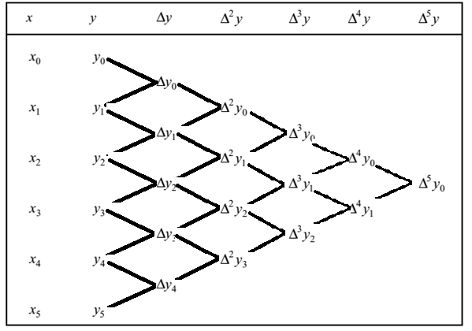
Numerical Methods
National University of Science and Technology, Islamabad

Slide 11

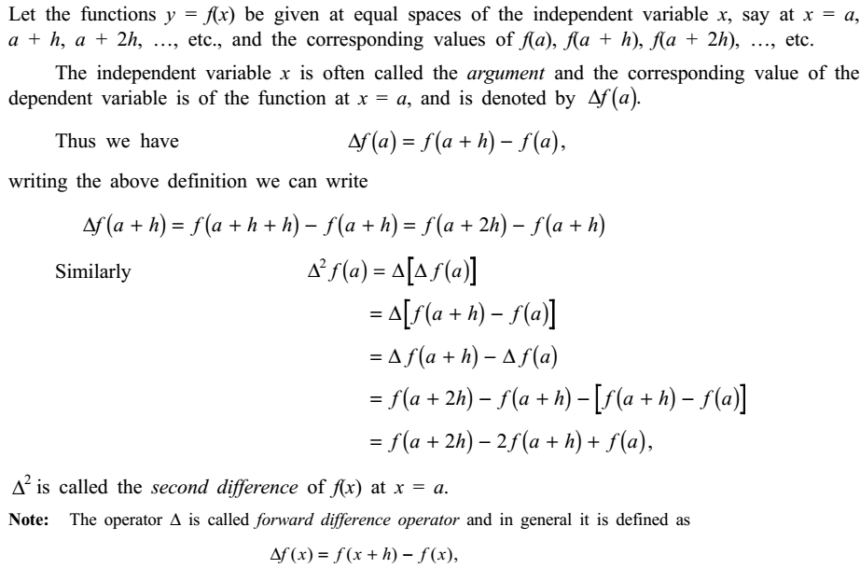
Numerical Methods
National University of Science and Technology, Islamabad

Slide 12
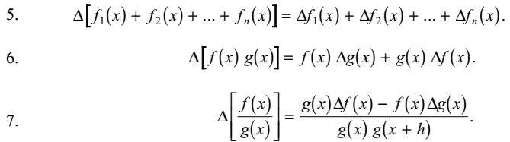
Numerical Methods
National University of Science and Technology, Islamabad

Slide 13
Numerical Methods
National University of Science and Technology, Islamabad

Slide 14
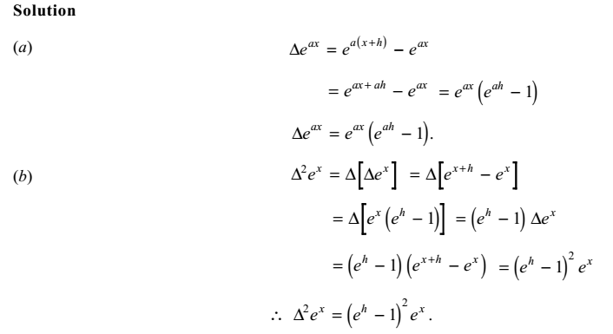
Numerical Methods
National University of Science and Technology, Islamabad

Slide 15
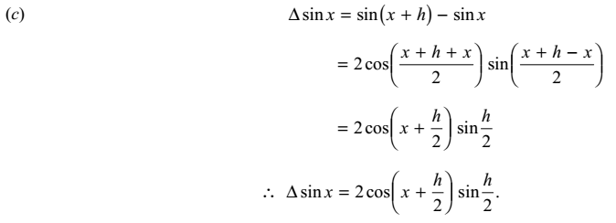
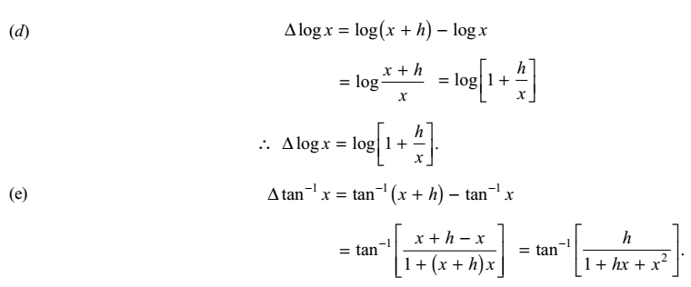
Numerical Methods
National University of Science and Technology, Islamabad

Slide 16
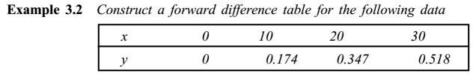
Numerical Methods
National University of Science and Technology, Islamabad

Slide 17
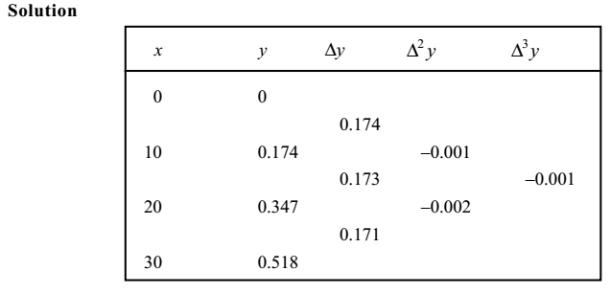
Numerical Methods
National University of Science and Technology, Islamabad

Slide 18
Numerical Methods
National University of Science and Technology, Islamabad

Slide 19
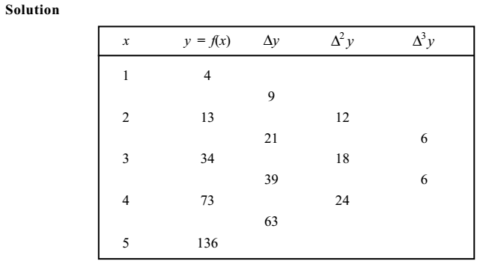
Numerical Methods
National University of Science and Technology, Islamabad

Slide 20
Numerical Methods
National University of Science and Technology, Islamabad

Slide 21
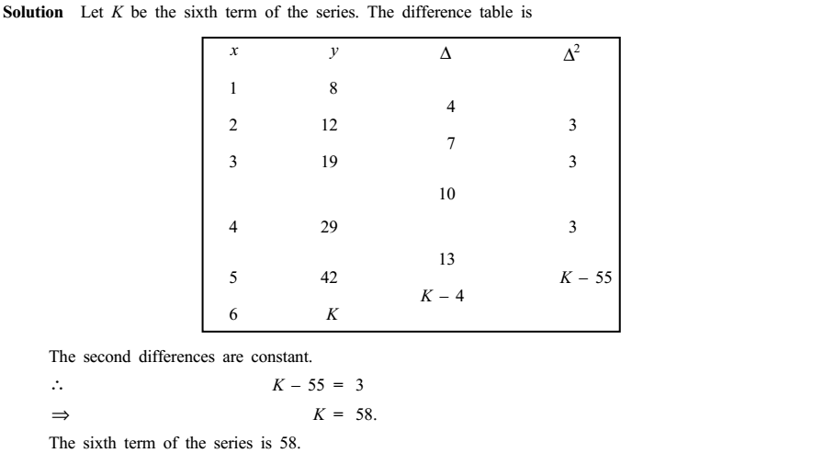
Numerical Methods
National University of Science and Technology, Islamabad

Slide 22
Numerical Methods
National University of Science and Technology, Islamabad

Slide 23
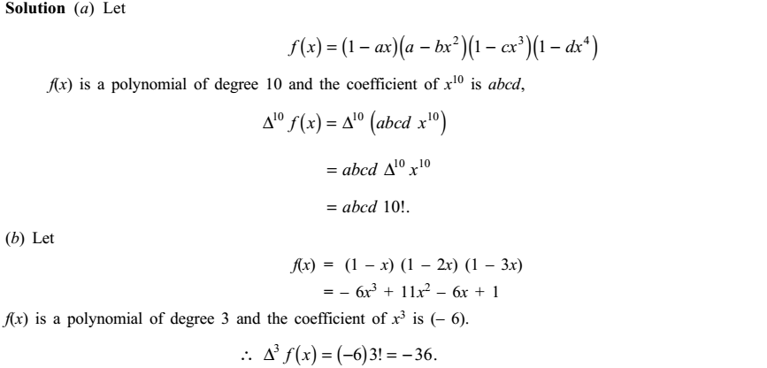
Numerical Methods
National University of Science and Technology, Islamabad

Slide 24

Numerical Methods
Practice Questions
Also study relation between Shift operator and Forward difference operator and its relavent
examples given in book
National University of Science and Technology, Islamabad

